Slide 1

Christ’s Church Must Speak the Same Thing Is Christ Divided?
I Corinthians 1:10-13

Slide 2
I Corinthians 1:10-13 (KJV)
¹⁰ Now I beseech you, brethren, by the name of our Lord Jesus Christ, that ye all speak the same thing, and that there be no divisions among you; but that ye be perfectly joined together in the same mind and in the same judgment.

Slide 3
I Corinthians 1:10-13 (KJV)
¹¹ For it hath been declared unto me of you, my brethren, by them which are of the house of Chloe, that there are contentions among you.

Slide 4
I Corinthians 1:10-13 (KJV)
¹² Now this I say, that every one of you saith, I am of Paul; and I of Apollos; and I of Cephas; and I of Christ.
¹³ Is Christ divided? was Paul crucified for you? or were ye baptized in the name of Paul?

Slide 5
Key Greek Terms and Concepts:
σχίσματα (schismata):
This Greek word for "divisions" or "splits" in verse 10 highlights the fractured state of the Corinthian church, which was tearing itself apart by forming factions around different human leaders.

Slide 6
Key Greek Terms and Concepts:
"Agree together":
Paul uses strong language, calling for the believers to be in agreement, "say the same thing," and be knit together in the same mind and purpose.

Slide 7
Key Greek Terms and Concepts:
"United in mind and conviction":
The ultimate goal is perfect unity in thought and judgment, a state that reflects the unity found in Christ himself.

Slide 8
Context of the Passage:
Divisions over Leaders:
Paul received reports from Chloe's people about the quarrels in Corinth, which stemmed from people aligning themselves with specific leaders like Paul, Christ Apollos, or Cephas, instead of focusing on Christ.

Slide 9
Context of the Passage:
CHRIST as the Center:
The argument is rooted in the fundamental truth that Christ is not divided, and therefore, his followers should not be divided either.

Slide 10
Context of the Passage:
The Church's Identity:
Paul stresses the importance of the church's identity in Christ, urging them to put aside their rivalries and demonstrate genuine unity.

Slide 11
Context of the Passage:
A Call to Harmony:
The passage serves as a tender but firm appeal by Paul to restore harmony to the body of Christ in Corinth, which had been marred by discord.

Slide 12
The Bible Clearly Commands Unity in Christ’s Church
God is Not the Author of Confusion
Man Must Not Add One Word to the Written Word of GOD (the Bible)

Slide 13
A. God is Not the Author of Confusion
I Corinthians 4:6 (KJV)
For God is not the author of confusion, but of peace, as in all churches of the saints.

Slide 14
B: Man Must Not Add One Word to the Written Word of GOD (the Bible)
Deuteronomy 4:2 (KJV)
Proverbs 30:5-6 (KJV)
Revelation 22:18-19 (KJV)

Slide 15
Deuteronomy 4:2 (KJV)
Ye shall not add unto the word which I command you, neither shall ye diminish ought from it, that ye may keep the commandments of the Lord your God which I command you.

Slide 16
Proverbs 30:5-6 (KJV)
⁵ Every word of God is pure: he is a shield unto them that put their trust in him.
⁶ Add thou not unto his words, lest he reprove thee, and thou be found a liar.

Slide 17
Revelation 22:18-19 (KJV)
¹⁸ For I testify unto every man that heareth the words of the prophecy of this book, If any man shall add unto these things, God shall add unto him the plagues that are written in this book:

Slide 18
Revelation 22:18-19 (KJV)
¹⁹ And if any man shall take away from the words of the book of this prophecy, God shall take away his part out of the book of life, and out of the holy city, and from the things which are written in this book.

Slide 19
Following Men and Not What’s Written in the Bible is Error (Sin)
I Corinthians 4:6 (KJV)
Matthew 15:9-14 (KJV)
II John 1:9-11 (NAS)

Slide 20
I Corinthians 4:6 (KJV)
And these things, brethren, I have in a figure transferred to myself and to Apollos for your sakes; that ye might learn in us not to think of men above that which is written, that no one of you be puffed up for one against another.

Slide 21
Matthew 15:9-14 (KJV)
⁹ But in vain they do worship me, teaching for doctrines the commandments of men.
¹⁰ And he called the multitude, and said unto them, Hear, and understand:

Slide 22
Matthew 15:9-14 (KJV)
¹¹ Not that which goeth into the mouth defileth a man; but that which cometh out of the mouth, this defileth a man. ¹² Then came his disciples, and said unto him, Knowest thou that the Pharisees were offended, after they heard this saying?

Slide 23
Matthew 15:9-14 (KJV)
¹³ But he answered and said, Every plant, which my heavenly Father hath not planted, shall be rooted up.
¹⁴ Let them alone: they be blind leaders of the blind. And if the blind lead the blind, both shall fall into the ditch.

Slide 24
II John 1:9-11 (NAS)
⁹ Anyone who goes too far and does not remain in the teaching of Christ, does not have God; the one who remains in the teaching has both the Father and the Son.

Slide 25
II John 1:9-11 (NAS)
¹⁰ If anyone comes to you and does not bring this teaching, do not receive him into your house, and do not give him a greeting;
¹¹ for the one who gives him a greeting participates in his evil deeds.

Slide 26

…that Christ died for our sins according to the scriptures; And that he was buried, and that he rose again the third day according to the scriptures:

Slide 27
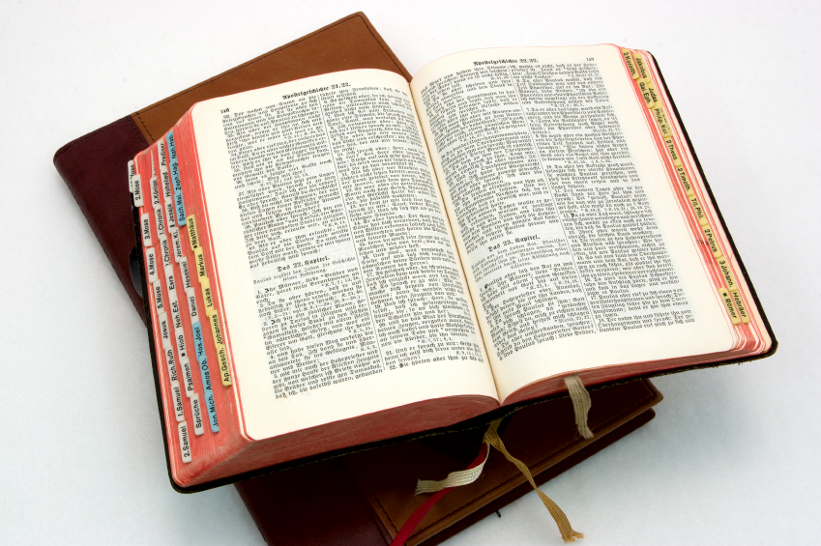
Hear: Romans 10:17
So then faith cometh by hearing, and hearing by the word of God.

Slide 28
Believe: Hebrews 11:6
But without faith it is impossible to please him: for he that cometh to God must believe that he is, and that he is a rewarder of them that diligently seek him.

Slide 29
Repent: Luke 13:3
I tell you, Nay: but, except ye repent, ye shall all likewise perish.

Slide 30
Confess: Matthew 10:32-33
32 Whosoever therefore shall confess me before men, him will I confess also before my Father which is in heaven.
33 But whosoever shall deny me before men, him will I also deny before my Father which is in heaven.

Slide 31
Baptize: Acts 22:16
And now why tarriest thou? arise, and be baptized, and wash away thy sins, calling on the name of the Lord.

